Slide 1
Power BI Embedded
FSI CSU SWARM

Slide 2
Introduction

Slide 3
Abstract and learning objectives
Abstract and learning objectives
Embed Power BI objects within applications

Slide 4
Embedding Functionalities
Embedding Power BI Content | The Power BI service (SaaS) and the Power BI Embedded service in Azure (PaaS) have APIs for embedding your dashboards and reports. This feature means you can access the latest Power BI features – such as dashboards, gateways, and app workspaces – when embedding your content.

Slide 5
Power BI Service
Provides cloud-based foundation for power BI platform
Accessible with browser through https://app.Powerbi.Com
Accessible through power BI mobile apps
Accessible to developers through power BI service API

Slide 6
Pay as you go

Slide 7

Using the Power BI Service API
Accessible by making direct REST calls against service
Accessible by using assembly DLL that abstracts away REST calls
Assembly DLL is named microsoft.Powerbi.Api.Dll
Assembly DLL part of nuget package (microsoft.Powerbi.Api)
Calling service requires authentication with azure active directory

Slide 8
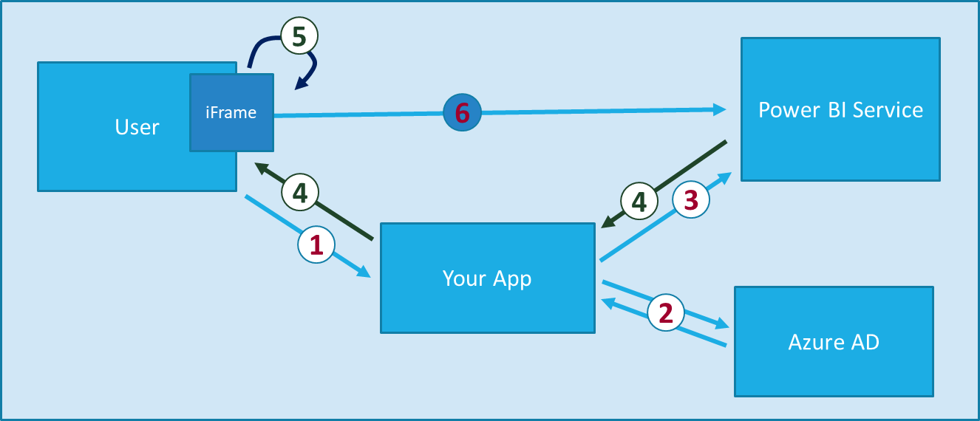
Power BI Embedding The Big Picture
User launches your app using a browser
App authenticates with azure active directory and obtains access token
App uses access token to call to power BI service API
App retrieves data for embedded resource and passes it to browser.
Client-side code uses power bi javascript api to create embedded resource
Embedded resource session created between browser and power BI service
Notes:
https://docs.microsoft.com/en-us/power-bi/developer/embedding

Slide 9
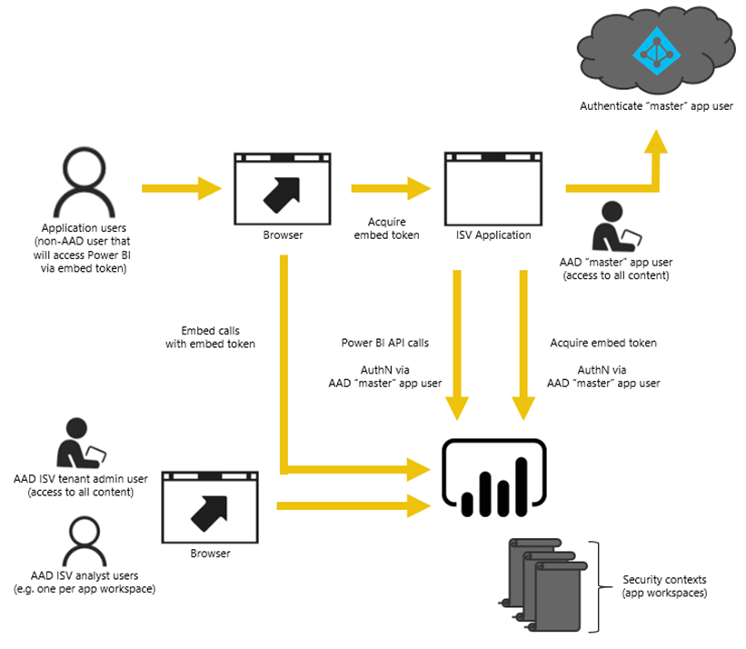
Power BI Embedding – The Big Picture
User launches your app using a browser
App authenticates with azure active directory and obtains access token
App uses access token to call to power BI service API
App retrieves data for embedded resource and passes it to browser.
Client-side code uses power bi javascript api to create embedded resource
Embedded resource session created between browser and power BI service

Slide 10
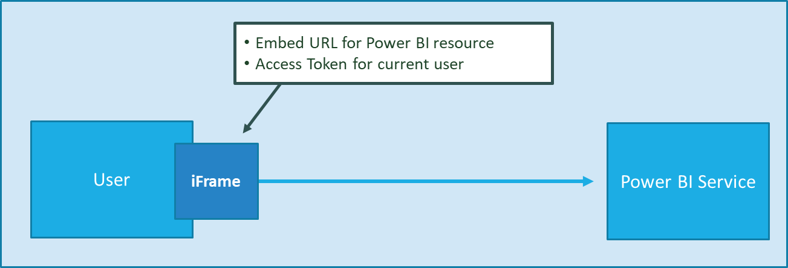
First Party Embedding
App authenticates current user with Azure AD
Your code accesses Power BI Service as current user
Embedding requires Azure AD access token for user
User requires Azure AD account and Power BI license
Your code has access to whatever user has access to

Slide 11
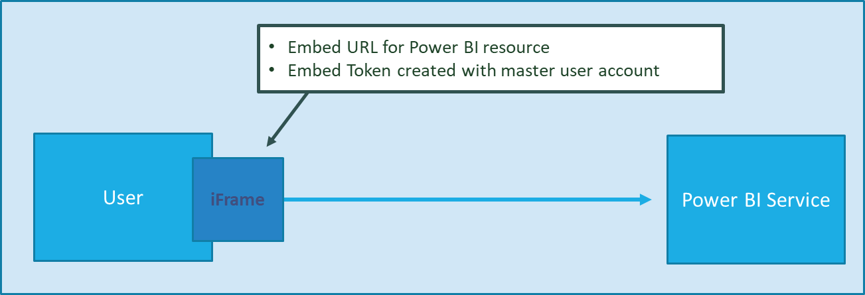
Third Party Embedding
App authenticates using Master User Account
Your code accesses Power BI Service as master user
Embedding uses embed token instead of access token
Users don’t need AAD accounts and Power BI licenses
Your code has access to whatever master has access to

Slide 12
First Party vs Third Party Embedding
What scenarios use first party embedding?
What scenarios use third party embedding?
Organizations where users have Power BI licenses
Embedding Power BI reports in SharePoint and Teams
Development should go beyond out-of-box experience
Scenarios where users don’t have Power BI licenses
Applications which have custom identity providers
Applications which use identity provider other than AAD

Slide 13
First Party vs Third Party Embedding Cont…
 | 1st Part Embedding | 3rd Party Embedding
Authentication flow | Authentication Code Grant Flow or Implicit Flow | Direct User Credentials
Identity used to call Power BI | Current User | Master User Account
Access to personal workspace | Yes | No
Access to app workspaces | Yes | Yes
Ability to reach non-licensed users | No | Yes
Supported Power BI Capacity SKUs | P* and EM* SKUs | P*, EM* and A* SKUs

Slide 14
Wrap Up

Slide 15
Wrap-up
Outcome
Identify the preferred solution for the case study
Identify solutions designed by other teams
Timeframe
15 minutes

